Slide 1
Software Engineering In Safety Critical Systems

Slide 2
Project Aim and Objectives
Aim
Investigation of approaches to safety critical Systems Development.
Objectives
Develop a safety critical System using Different safety critical languages
Compare Usability and security of these languages.
Investigate Issues into Software Development for safety critical Systems

Slide 3
Scenario
Develop a railway Crossing simulation.
Key Features
Editable Scenario (time between trains arrival/ speed)
Signal For barriers
Changeable barrier time down.
Goal of System
Be able to figure a safe solution to barrier time down and barrier time up.

Slide 4
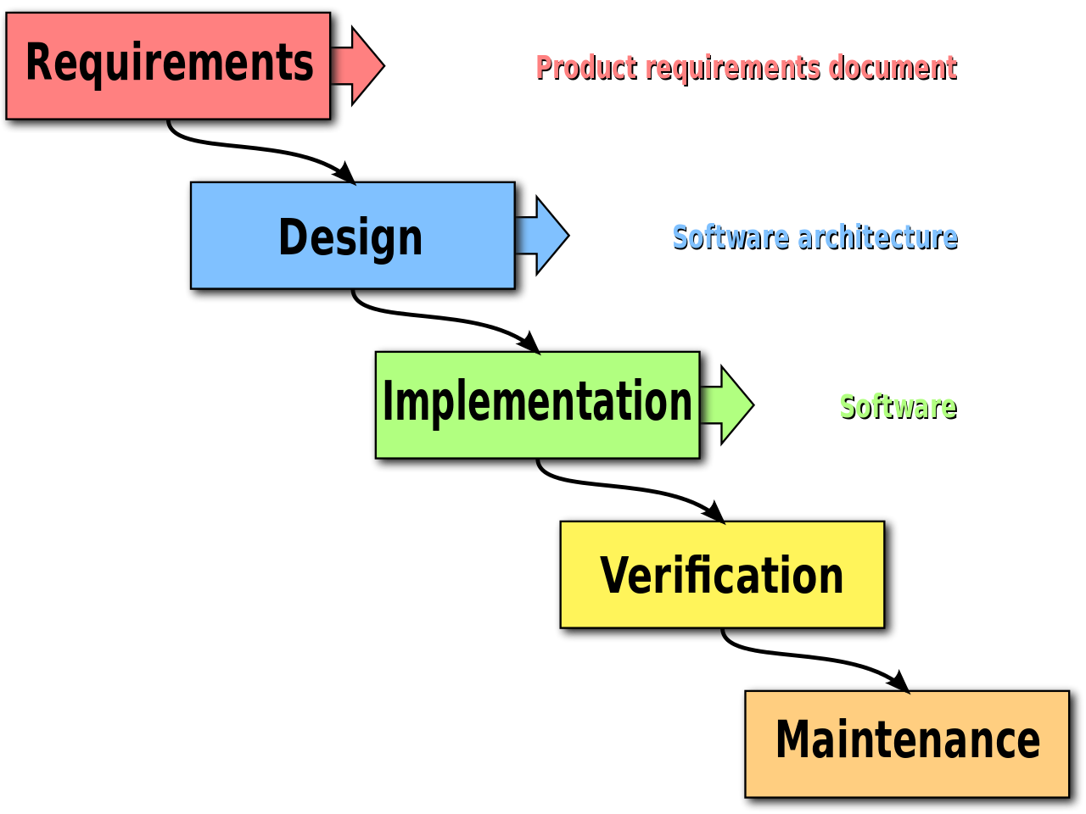
Software Development Process
Waterfall
https://upload.wikimedia.org/wikipedia/commons/thumb/e/e2/Waterfall_model.svg/1280px-Waterfall_model.svg.png

Slide 5
Safety Critical Languages
Languages I will be developing in:
Spark: based on the ada programming language. has its own set of source code analysis(static verification) tools and design method for developing high insurance software.
Spec#: based on C#, has features very much like spark (contracts, invariants, pre and postconditions) extends the features of C#

Slide 6
Evaluation
Ease of Use
Effectiveness
Security
Features

Slide 7
Project Milestones and deliverables
Task Date
- Look into issues for safety Critical Development. 23/11/2016
- Fully Implement an Evaluation Criteria 1/12/2016
- Learn Spark ada and Spec# 20/12/2016
- Develop Systems 01/02/2017
- Evaluation and Testing 21/02/2017

Slide 8
Any Questions?

